Slide 1
NATURAL NUMBERS AND WHOLE NUMBERS

Slide 2
Sub-Topic In this chapter, students will learn about-
Recapitulation of numbers(Indian and International system of numeration)
Successor and predecessor of whole numbers
Roman Numerals: Converting Hindu Arabic numerals into roman numerals and vice versa.
Operations on whole numbers: Addition, Subtraction, Multiplication and division of whole numbers and their properties.
Solving numerical and word problems using Distributive property of Multiplication.
Estimation of sum or difference.
Estimation of product of numbers.
Brackets and their use

Slide 3
Recapitulation
Period , place value and face value of each digit of these numbers.
Indian and International system of numeration of numbers up to 99999999
Addition , subtraction , multiplication and division of these numbers.

Slide 5
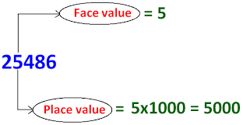
Example:1 The face value and place value of 5 in 25486 is -

Slide 6
Example 2 The difference between the place value and face value of 8 in 38,46,197 is:
Place value of 8 in 38,46,197 = 8,00,000
Face value of 8 in 38,46,197 = 8
Difference = 8,00,000 – 8
= 7,99,992

Slide 7
Hindu-Arabic(Indian) System of Numeration
In Indian number system, ten symbols 0, 1, 2, 3, 4, 5, 6, 7, 8, 9 are used to write numeral. Each of this number is called a digit.
Values of the places in the Indian system of numeration are Ones, Tens, Hundreds, Thousands, Ten thousand, Lakhs, Ten Lakhs, Crores and so on. The following place value chart can be used to identify the digit in any place in the Indian system.

Slide 8
Hindu-Arabic(Indian) System of Numeration
Commas are placed to the numbers to help us read and write large numbers easily. As per Indian system of numeration, the first comma is placed after the hundreds place. Commas are then placed after every two digits.
Let us consider some examples:
Example 1: Using Hindu-Arabic system, read the number 850746
Solution: 8,50,746 – Eighty Lakh Fifty Thousand Seven Hundred Forty Six.
Example 2: Write four crores fifteen lakh fifty thousand five hundred twenty seven in the numeral form using the Hindu-Arabic system.
Solution: 4,15,50,527

Slide 9
International System of Numeration
As per International numeration system, the first comma is placed after the hundreds place. Commas are then placed after every three digits.
Values of the places in the International system of numeration are Ones, Tens, Hundreds, Thousands, Ten Thousands, Hundred Thousands, Millions, Ten millions and so on. 1 million = 1000 thousand, 1 billion = 1000 millions.

Slide 10
International System of Numeration
Example 1: Using the International system, write the number; Six million, four hundred and eleven thousand, two hundred and sixty.
Solution: 6,411,260.
Example 2: Using the international system, read the number 7456123.
Solution: Seven million Four Hundred Fifty six thousand one hundred twenty three.
Example 3: Write the number in words: 12,367,169.
Solution: Twelve million, three hundred and sixty-seven thousand, one hundred and sixty-nine.
Example 4: Write seven hundred forty three million eight hundred thirteen thousand two hundred fifty six in the numeral form using the international system.
Solution: 743,813,256.

Slide 11
Indian Numeration | Ten Crore | Crore | Ten lakh | Lakh | Ten Thousand | Thousand | Hundred | Ten | One
Numbers | 100000000 | 10000000 | 1000000 | 100000 | 10000 | 1000 | 100 | 10 | 1
International Numeration | Hundred Million | Ten Million | Million | Hundred Thousand | Ten Thousand | Thousand | Hundred | Tens | Ones
Comparing the two numeral systems we observe that: 100 thousands = 1 lakh 1 million = 10 lakhs 10 millions = 1 crore 100 millions= 10 crores

Slide 12
Example 1: How many lakhs make 5 millions?
Solution: 5 millions = 5 x 1 million
= 5 x 10 lakhs
= 50 lakhs
Example2: How many millions make 3 crore?
Solution: 3 crore = 3 x 1crore
= 3 x 10 millions
= 30 millions

Slide 13
Formation of numbers with the given digits:
Numbers may be formed with or without the repetition of digits. Let us observe some of the formation of numbers without the repetition of digits.
2-digit numbers formed
with digits 2 and 3 are: 23 , 32
But with the digit 0 and the digit 6, only the number 60 is formed. The number 06 is not a two-digit number.
3-digit numbers formed
with digits 2, 3, and 4 are: 234, 243, 324, 342, 423, 432
(6 numbers each of 3 digits)
with digits 0, 1 and 5 are: 105, 150, 501, 510
(only 4 numbers of 3 digits)

Slide 14
Suggested Video

Slide 15
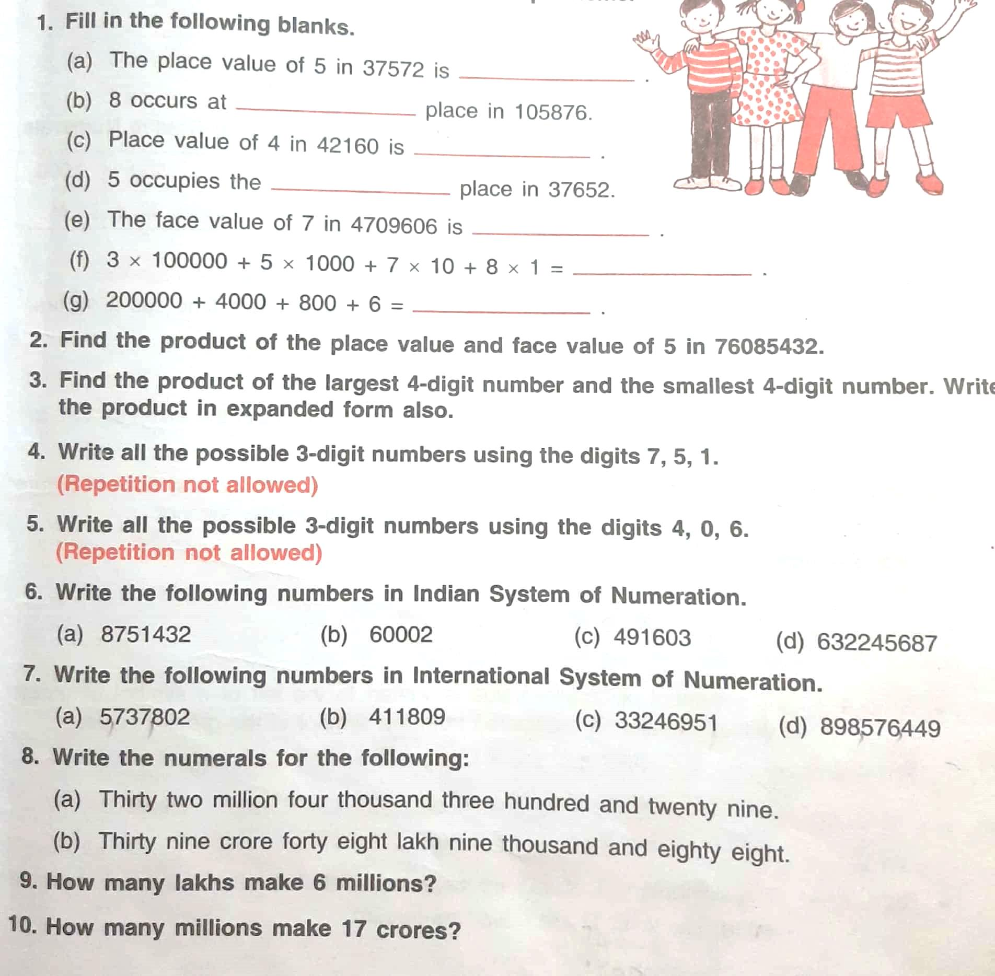
Practice questions:

